Slide 1

QUANTIFYING THE UNCERTAINTY IN Wind Power Production Using Meteodyn WT
Bray k. Moll
Undergraduate Research ASSISTANT
Northern Arizona university
Thomas l. Acker, PhD
Professor OF Mechanical engineering
Northern Arizona university
October 31, 2017

Slide 2
Objectives
Perform an Uncertainty Quantification in Wind Power Predictions from Meteodyn WT
  Use Computation Resources available at the Energy and Computational Modeling (ECM) Lab.
Determine:
  Numerical Uncertainty in Wind Speed Prediction
Quantify Total Uncertainty in Model Results
  Velocity with 95% Confidence

Slide 3
Background
Simulation Error
Modeling Error
Numerical Error
Input Error
Round-Off Error
Iterative Error
Statistical Sampling Error
Discretization Error

Slide 4



Software
Geographic Information System (GIS)
Used to develop the elevation file
Computational Fluid Dynamics (CFD) Software
Solves the Nonlinear, Steady, incompressible, isothermal Reynolds Averaged Naiver Stokes (RANS) equations.
Uses a one-equation closure model
Matrix Laboratory
Used for data reduction and visualization

Slide 5
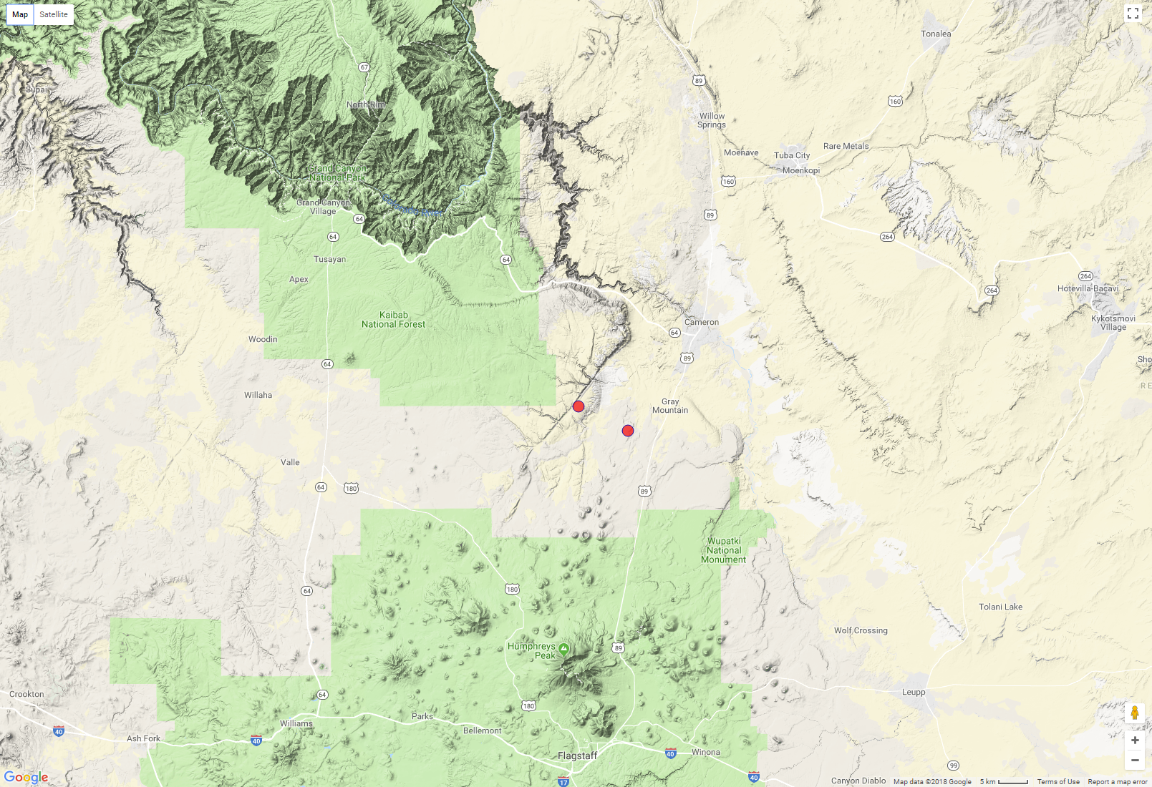
Location
Grand Canyon
Flagstaff

Slide 6
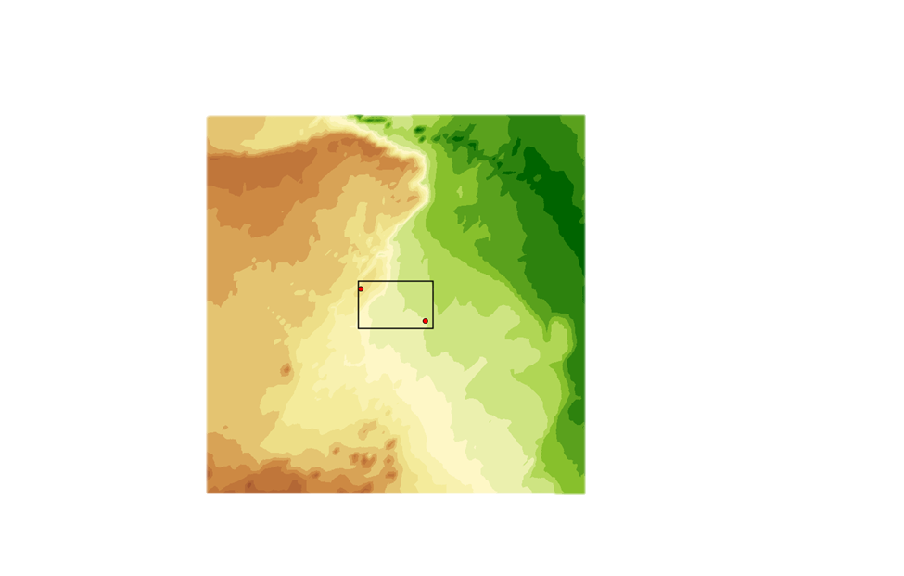
Location
Grand Canyon
Flagstaff

Slide 7
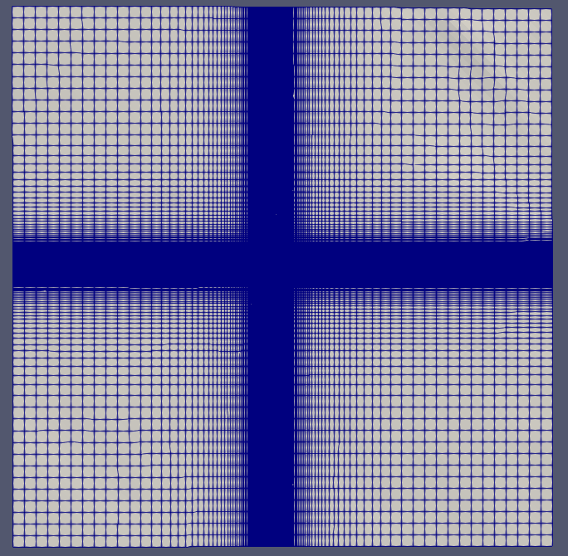
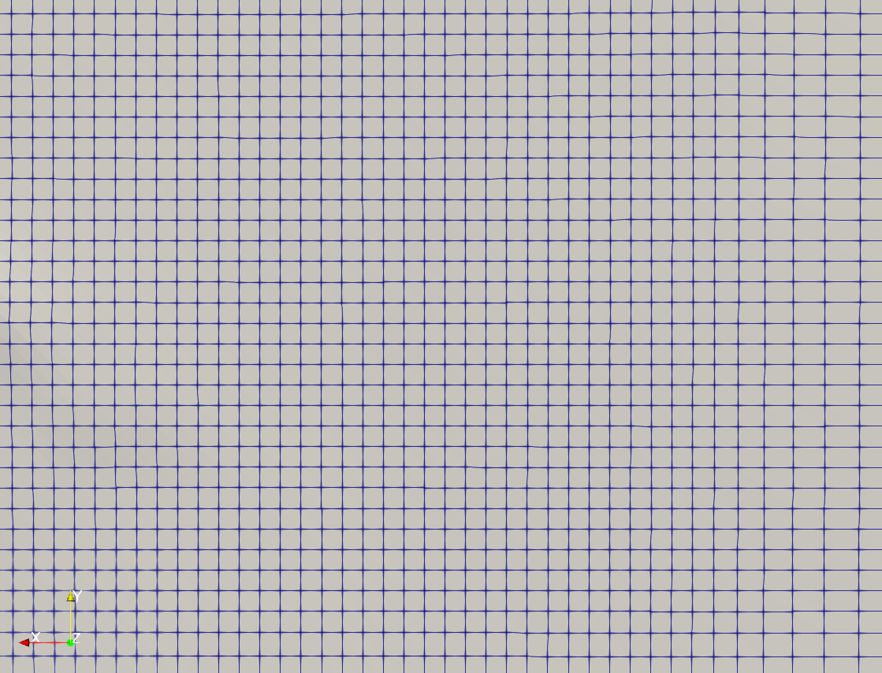
Mesh

Slide 8

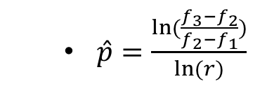
Richardson Extrapolation
  3 Systematically Refined Mesh’s
  $\hat{p}=\frac{ln⁡(\frac{f_{3}−f_{2}}{f_{2}−f_{1}})}{ln⁡(r)}$
  $GCI=F_{s}\frac{\left|f_{h}−f_{rh}\right|}{r^{p}−1}$
Fine
Med
Course
Intersecting Nodes

Slide 9
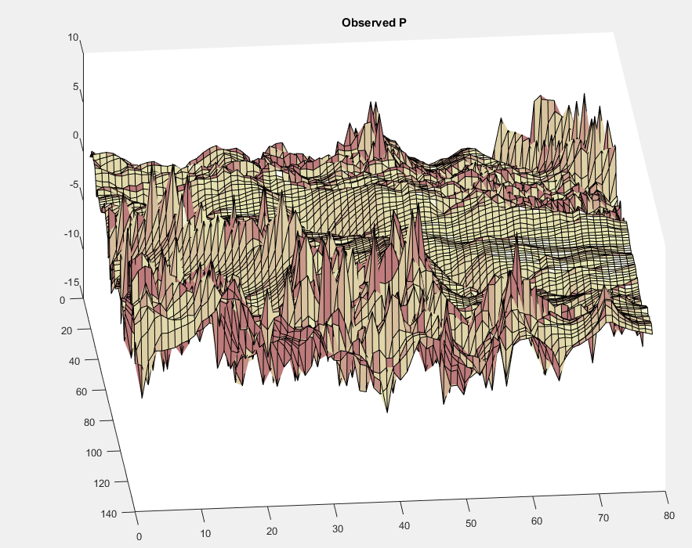
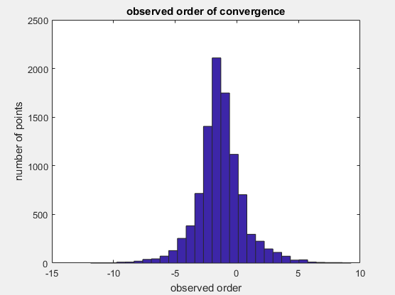
Synthesis Results
Average Order of convergence = -1.33

Slide 10
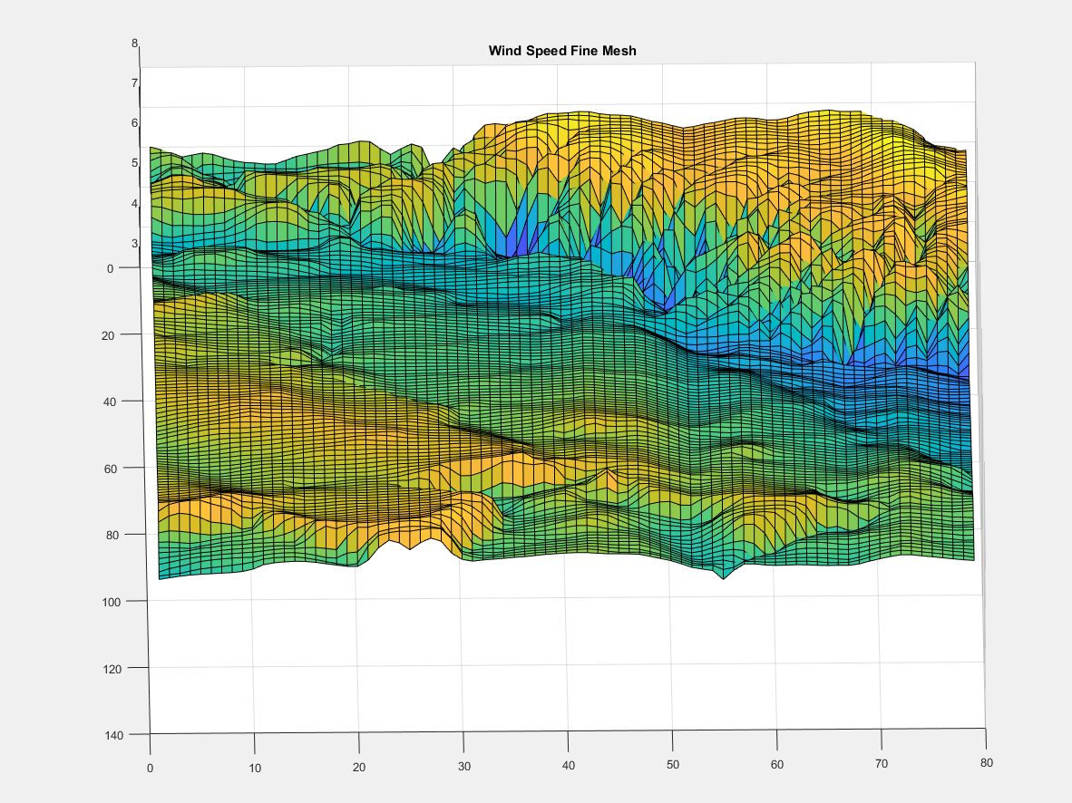
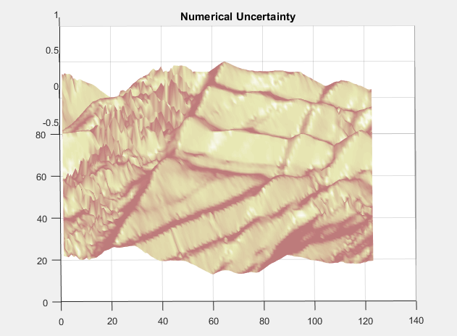
Synthesis Results

Slide 11
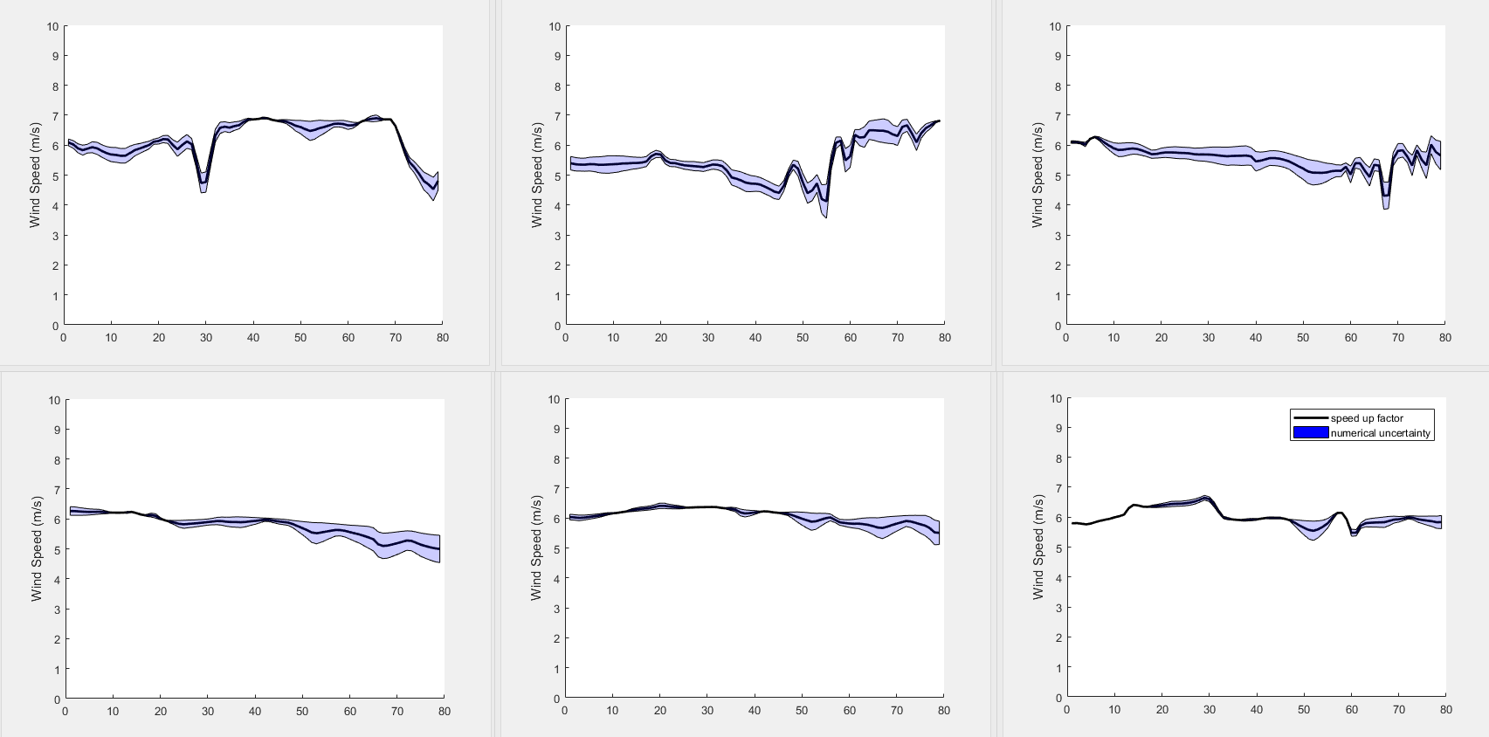
Synthesis Results

Slide 12
conclusion
A significant difference between the theoretical and observed order of convergence
  Theoretical = 2
  Observed= -1.33
Not in the asymptotic range
  Finer Mesh
Iterative Error Influence
  Increase the number of iterations

Slide 13
Acknowledgements
Dr. Tom Acker
  Energy and Computational Modeling (ECM) Lab
Kathleen Stigmon & Dr. Nadine Barlow
  NAU Nasa Space Grant

Slide 14
Questions?

Slide 15
References
[1] ASME, “Standard for Verification and Validation in Computational Fluid Dynamics and Heat Transfer,” ASME V&V 20-2009, 2009.
[2] T. S. Phillips, C. Roy, D. Tafti, W. Mason, and E. Cliff, “Extrapolation-based Discretization Error and Uncertainty Estimation in Computational Fluid Dynamics,” 2012.
[3] C. Roy, “Review of Discretization Error Estimators in Scientific Computing,” AIAA Pap., no. January, pp. 1–29, 2010.
[4] L. F. Richardson, “The Approximate Arithmetical Solution by Finite Differences of Physical Problems involving Differential Equations, with an Application to the Stresses in a Masonry Dam,” Trans. R. Soc. London, vol. 210, 1910.
[5] W. Oberkampf and C. Roy, Verification and Validation in Scientific Computing. New York: Cambridge University Press, 2010.
[6] P. J. Roache, “Perspective: A Method for Uniform Reporting of Grid Refinement Studies,” J. Fluids Eng., vol. 116, no. 405, 1994.
[7] Meteodyn, “Technical note -meteodyn WT.”
[8] D. Martindale, “Distributed Wind Resource Assessment Using Meteodyn Wt,” Northern Arizona University, 2016.

